Slide 1
Digital Portfolio
STUDENT NAME:VENKATESH P
REGISTER NO AND NMID: 2422J0161 AND 52498A2532032DEA9DC4FA0B0691F818
DEPARTMENT: BCA
COLLEGE: KPR College of Arts Science and Research
UNIVERSITY:BHARATHIYAR UNIVERSITY

Slide 2
PROJECT TITLE
Title: Web Development Portfolio using HTML,CSS AND JAVASCRIPT

Slide 3


AGENDA
Problem Statement
Project Overview
End Users
Tools and Technologies
Portfolio design and Layout
Features and Functionality
Results and Screenshots
Conclusion
Github Link
3/21/2024 Annual Review

Slide 4

PROBLEM STATEMENT
Create a simple, responsive portfolio website using HTML, CSS, and JavaScript to showcase personal skills, projects, and contact information. The website should be easy to navigate, visually clean, and accessible on all devices.

Slide 5

PROJECT OVERVIEW
A modern single-page website designed to highlight web development skills.
User-friendly sections: Introduction, Projects, About, Contact Form, and smooth navigation.
Fully responsive layout with stylish elements using CSS and interactive features via JavaScript.

Slide 6

WHO ARE THE END USERS?
The end users of a web development portfolio website are primarily potential employers, recruiters, and clients who seek to evaluate the developer's skills, experience, and project work for professional opportunities. Other users can include collaborators, peers, and anyone interested in learning about the developer's abilities and background.

Slide 7

TOOLS AND TECHNIQUES
Tools: Visual Studio Code (code editor), Chrome (browser), Git/GitHub (version control), Live Server (live preview).
Techniques: Use HTML for structure, CSS for responsive styling, JavaScript for interactivity like form validation and menu toggle. Focus on simple, clean, and responsive design for all devices.

Slide 8
POTFOLIO DESIGN AND LAYOUT
Use a clean, simple, and professional layout.
Include clear navigation: Home, About, Projects, Contact.
Showcase projects with images and descriptions.
Make it responsive for all devices.
Keep consistent colors, fonts, and spacing.
Include a call-to-action for easy contact.

Slide 9
FEATURES AND FUNCTIONALITY
Homepage: Introduce yourself clearly and professionally.
Projects Section: Showcase best work with descriptions, images, and links.
About Me: Share background, skills, and experience.
Contact Form: Easy way for visitors to reach you.
Responsive Design: Looks great on all devices.
Call to Action: Encourage contacting or viewing projects.
Social Links: Connect to LinkedIn, GitHub, etc.
Optional: Testimonials and downloadable resume.

Slide 10
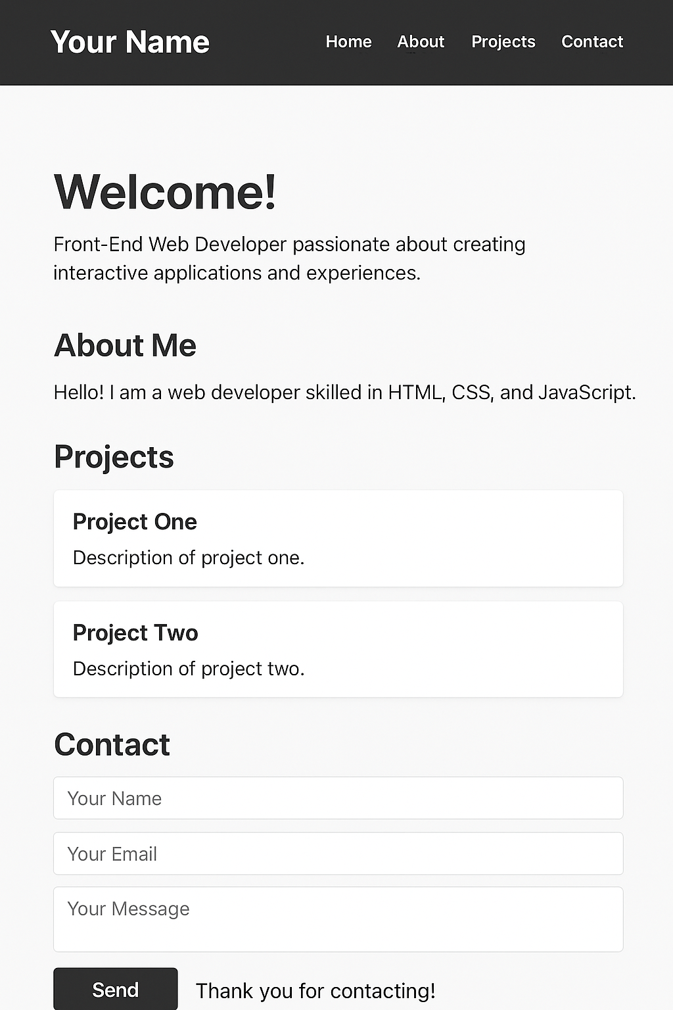

RESULTS AND SCREENSHOTS
3/21/2024 Annual Review

Slide 11
CONCLUSION
In conclusion, creating a web development portfolio using HTML, CSS, and JavaScript is an essential step to showcase your skills, projects, and professional identity effectively. A successful portfolio is clean, responsive, and easy to navigate, highlighting your best work with clear descriptions and contact options. Regular updates, thoughtful design, and including key features like project showcases and contact forms help make a strong impression on potential employers and clients. This portfolio serves as a powerful tool for career growth and professional networking in the web development field.

